Slide 1

Week 9:
Autoencoder and one-shot learning
Machine Learning Using Tensorflow
Shu-Ting Pi, PhD
UC Davis

Slide 2
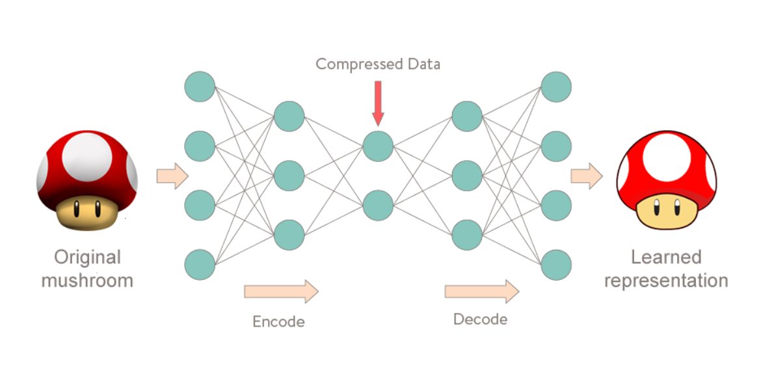
What is autoencoder?
Deep Learning Using Tensorflow and Keras
Shu-Ting Pi

Slide 3
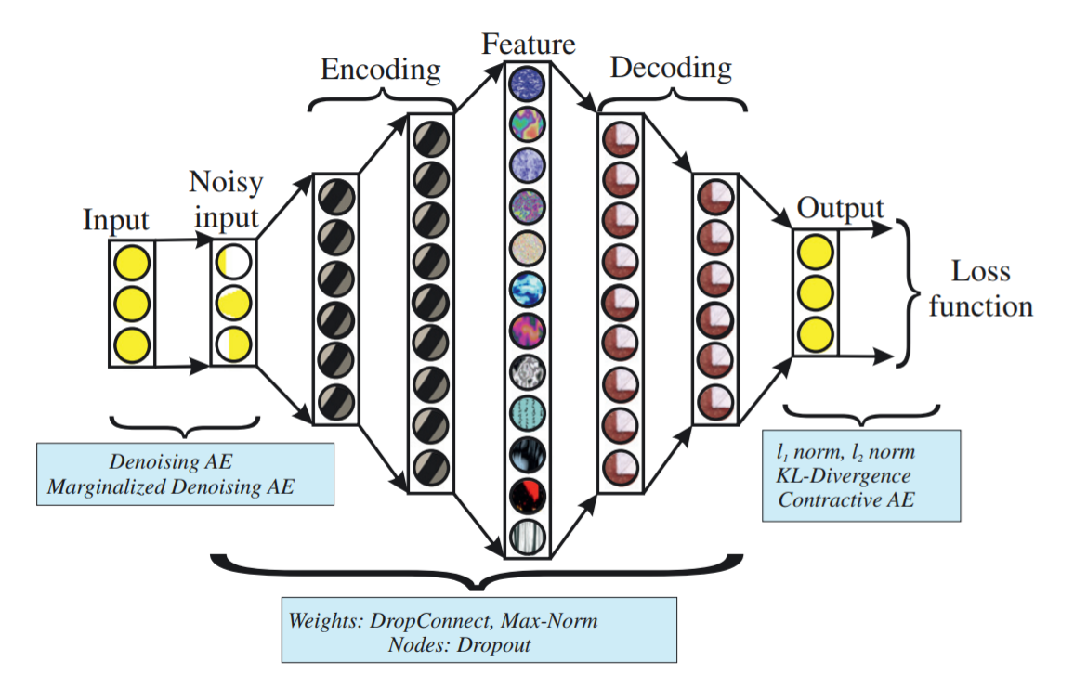
Sparse autoencoder
L1 regularization
The lantern variable will become very “sparse”
Deep Learning Using Tensorflow and Keras
Shu-Ting Pi

Slide 4
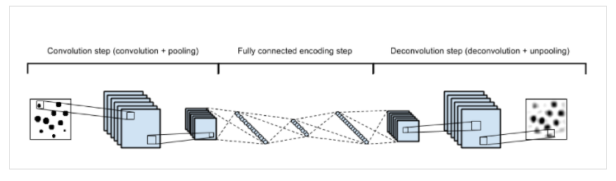
CNN autoencoder
Deep Learning Using Tensorflow and Keras
Shu-Ting Pi

Slide 5
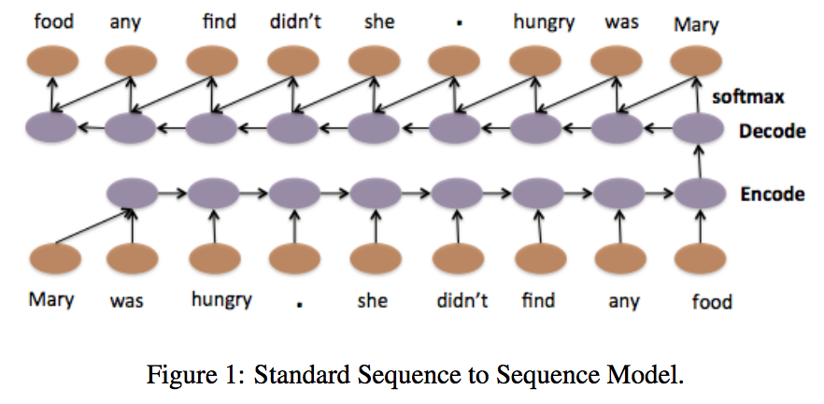
Seq2Seq autoencoder
Deep Learning Using Tensorflow and Keras
Shu-Ting Pi

Slide 6
Application of autoencoder

Slide 7
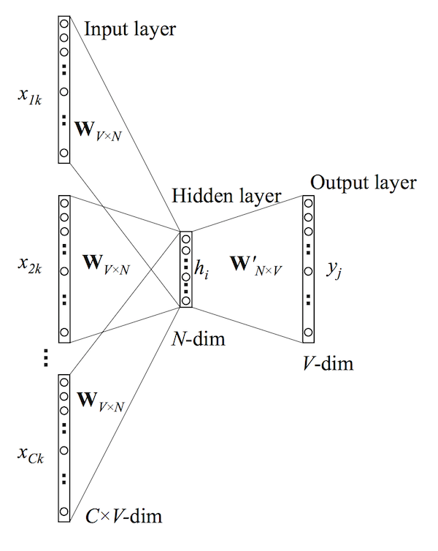
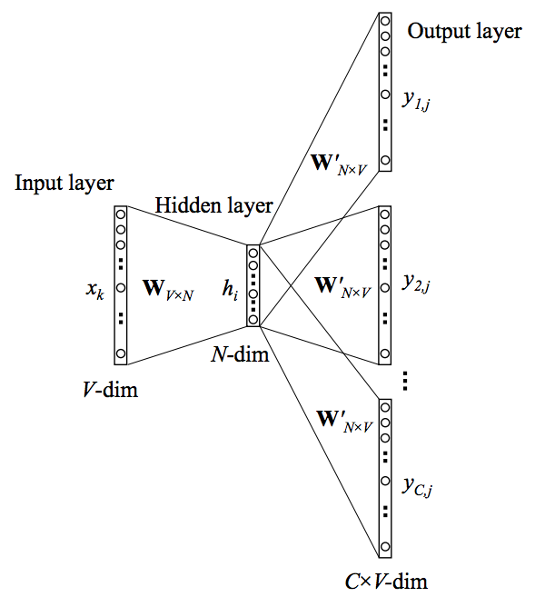
Word2Vec
CBOW
Skip-gram
Deep Learning Using Tensorflow and Keras
Shu-Ting Pi

Slide 8
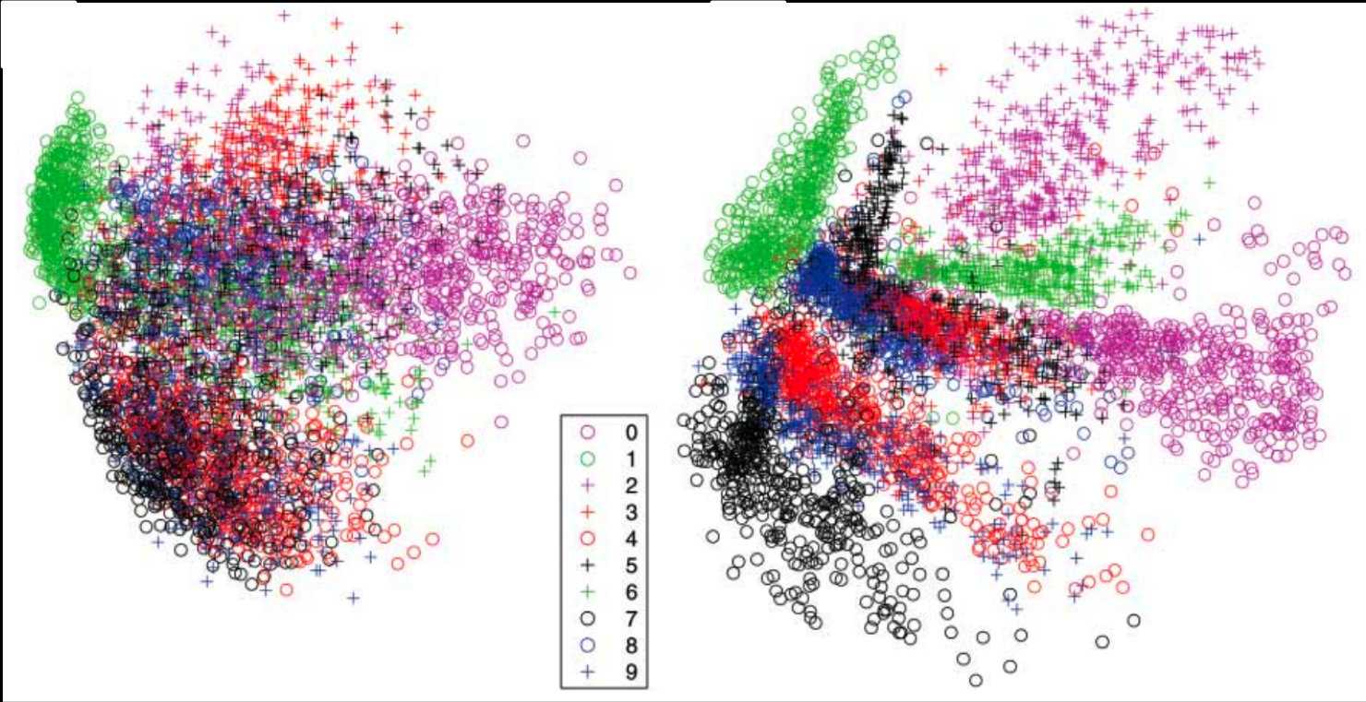
Clustering of MNIST
PCA
Autoencoder
Autoenoder works much better than PCA, so what is autoencoder?
Deep Learning Using Tensorflow and Keras
Deep Learning Using Tensorflow and Keras
Shu-Ting Pi
Shu-Ting Pi

Slide 9
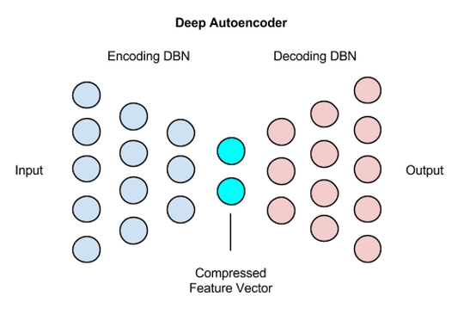
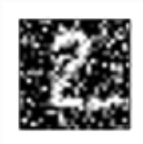

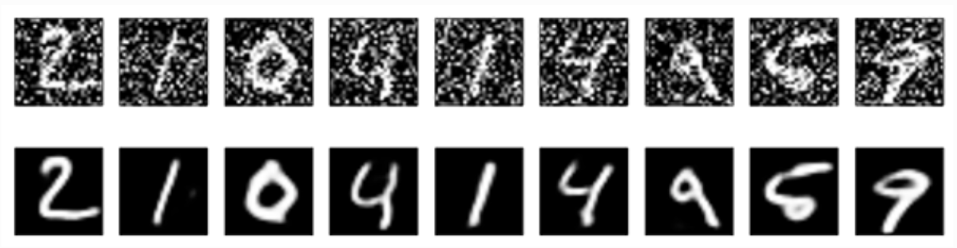
Signal denoising
Deep Learning Using Tensorflow and Keras
Shu-Ting Pi

Slide 10
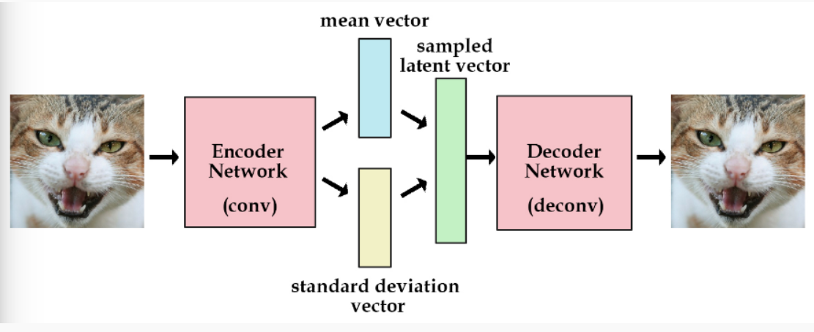
Variation autoencoder
Normal distribution
Fact: the latent vector is generated by an input in autoencoder
Question: How can we aviod this issue
* loss = (diff of input and output image) + (KL div of laten vector and normal dist)
Deep Learning Using Tensorflow and Keras
Shu-Ting Pi

Slide 11
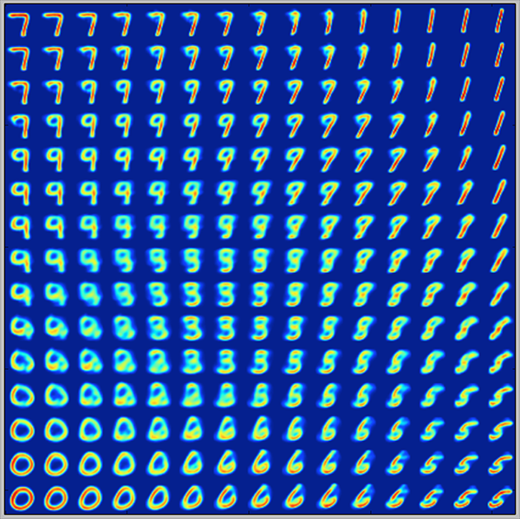
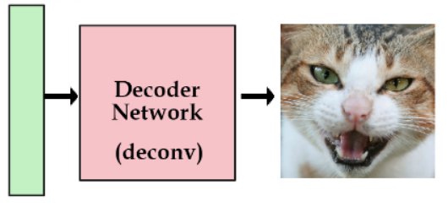
VAE is also a generative model
Random
number
Deep Learning Using Tensorflow and Keras
Shu-Ting Pi

Slide 12
One-Shot learning (Siamese networks)

Slide 13
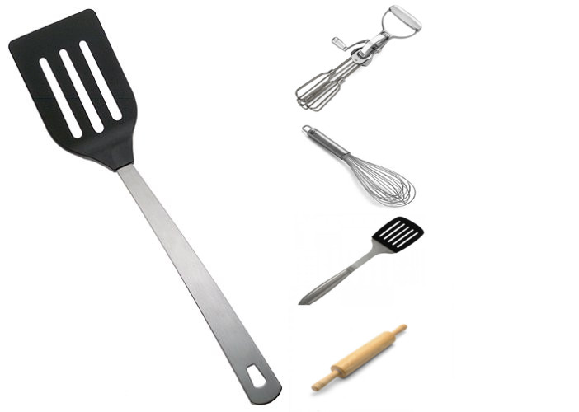
What is one-shot learning?
Does human need thousands or million images to recognize them?
Deep Learning Using Tensorflow and Keras
Shu-Ting Pi

Slide 14
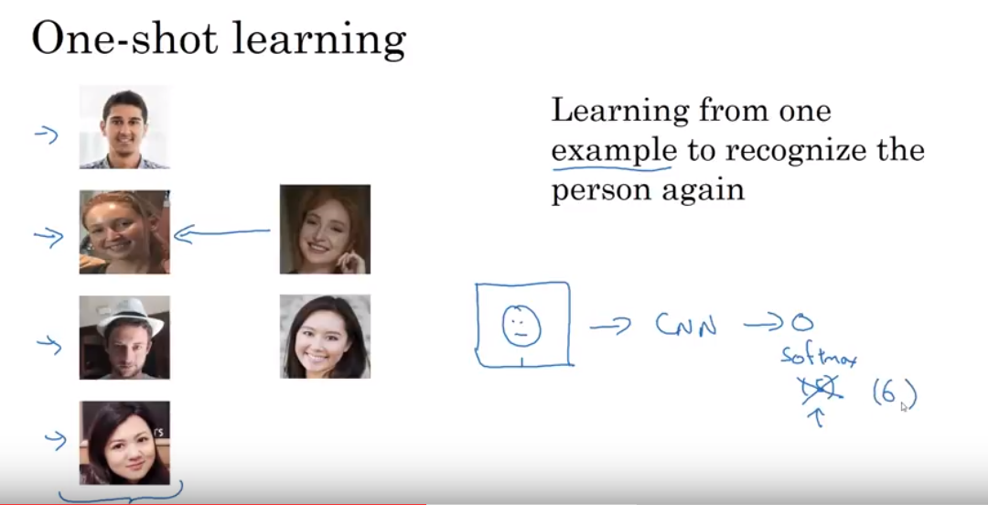
Real life application
Deep Learning Using Tensorflow and Keras
Shu-Ting Pi

Slide 15
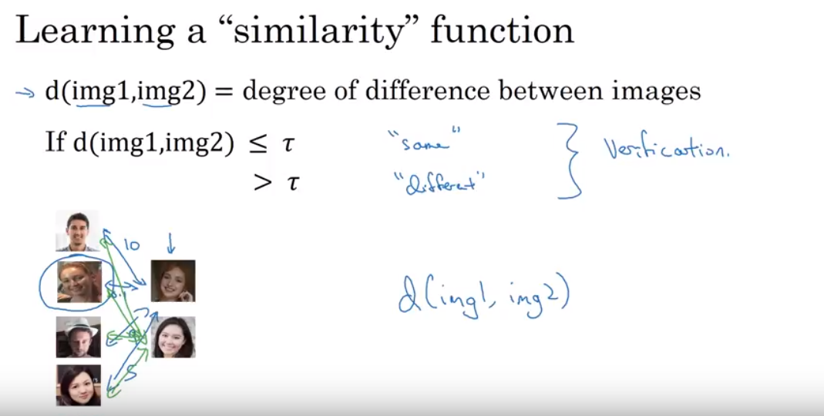
Equivalence Network
Deep Learning Using Tensorflow and Keras
Shu-Ting Pi

Slide 16
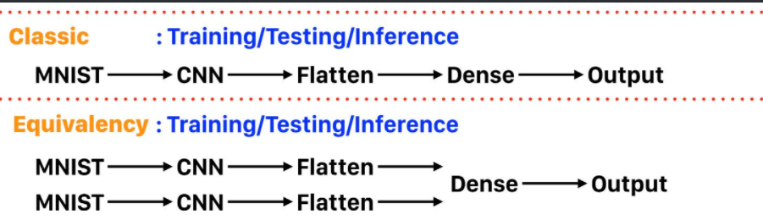
Equivalence Network
Pretrained
Trainable
Possibility
Deep Learning Using Tensorflow and Keras
Shu-Ting Pi

Slide 17
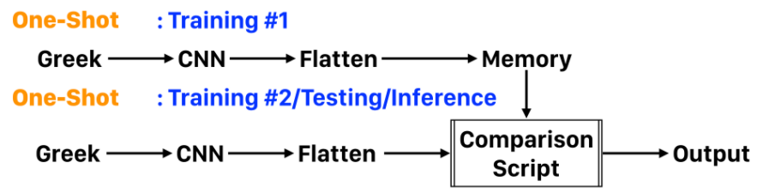
A few-shot learning
Pretrained, e.g. VGG19
Probability
Deep Learning Using Tensorflow and Keras
Shu-Ting Pi

